Slide 1
Move Out Sale
Pick up in EVGR B
Contact: 815-474-7120,
monesto@stanford.edu
Venmo:@Massimo-Onesto

Slide 2
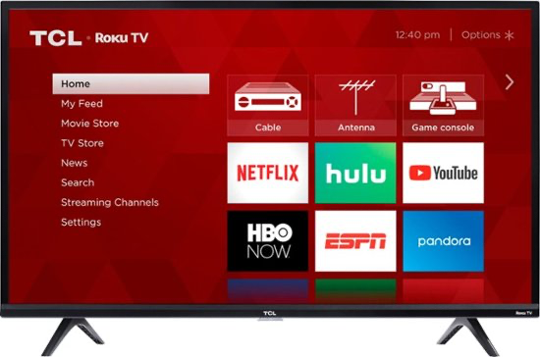
Item: TCL - 40" Class 3-Series LED Full HD Smart Roku TV
https://www.bestbuy.com/site/tcl-40-class-3-series-led-full-hd-smart-roku-tv/6302321.p?skuId=6302321&ref=212&loc=1&extStoreId=685&ref=212&loc=1&gclid=Cj0KCQjwuO6WBhDLARIsAIdeyDIl3psFw1KypjLLSov2j5BO0EVkLNC6u5_KfnNds3L9tARIuEbg2JMaAhNHEALw_wcB&gclsrc=aw.ds
Condition: Like-new, needs replacement remote (~$5-10)
Original Price: $220
Sale Price: $100
Pending

Slide 3
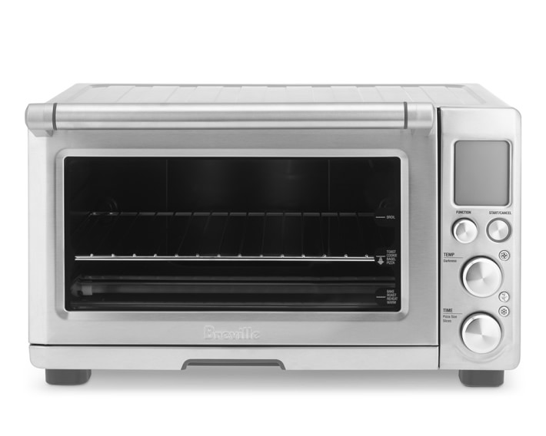
Item: Breville Smart Oven with Convection
https://www.williams-sonoma.com/products/breville-smart-convection-oven/?catalogId=79&sku=6926232&cm_ven=PLA&cm_cat=Google&cm_pla=Electrics%20%3E%20Toasters%20%26%20Toaster%20Ovens&region_id=820120&cm_ite=6926232_14571727863&gclid=Cj0KCQjwuO6WBhDLARIsAIdeyDLUlhyg0RrqbRssv9KRc6zVefG6Pxqg5ntDSVAfcCkolKB-1X7A0ZAaAnaAEALw_wcB
Condition: Good
Original Price: $220
Sale Price: $110

Slide 4
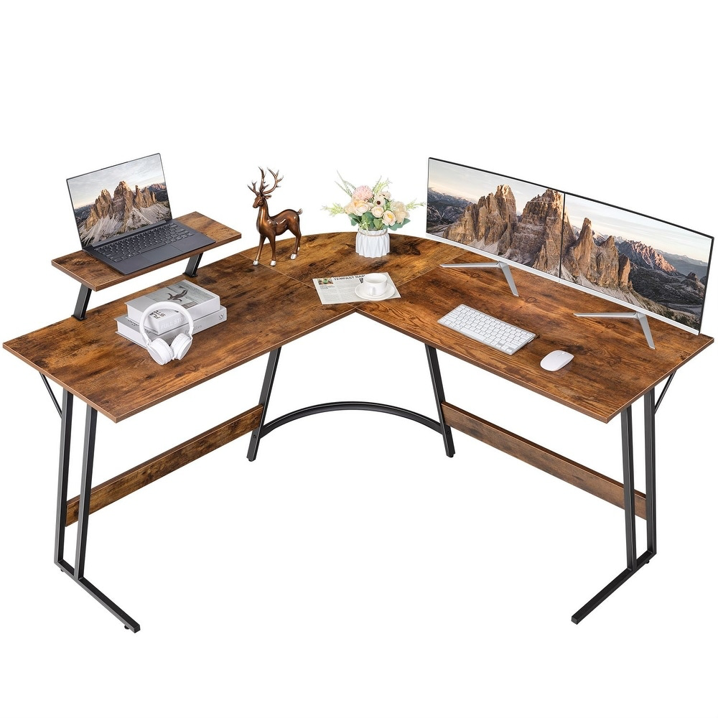
Item: Homall L-Shaped Computer Desk Modern Corner Desk with Small Table - N/A - Brown
https://www.overstock.com/Home-Garden/Tables/18552/subcat.html?featuredproduct=35458386&featuredoption=68009784&ci_sku=39607994-000-001&cnc=US&cid=317140&track=pspla&gclid=Cj0KCQjw2_OWBhDqARIsAAUNTTHPI5QdWSWWzyKSbkRHkpVlWBrqT-Z7emrkVyVRpHklyCww5onZ-94aApyQEALw_wcB
Condition: Like-new
Original Price: $100
Sale Price: $50

Slide 5
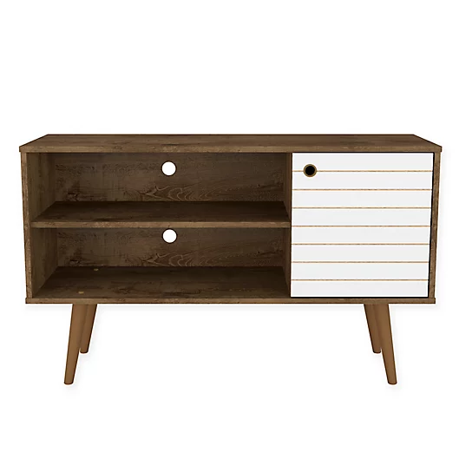
Item: Liberty 43 in. Rustic Brown and White TV Stand Fits TVs Up to 46 in.
https://www.homedepot.com/p/Manhattan-Comfort-Liberty-43-in-Rustic-Brown-and-White-Composite-TV-Stand-Fits-TVs-Up-to-46-in-with-Storage-Doors-212BMC96/305467745
Condition: Good
Original Price: $100
Sale Price: $40

Slide 6
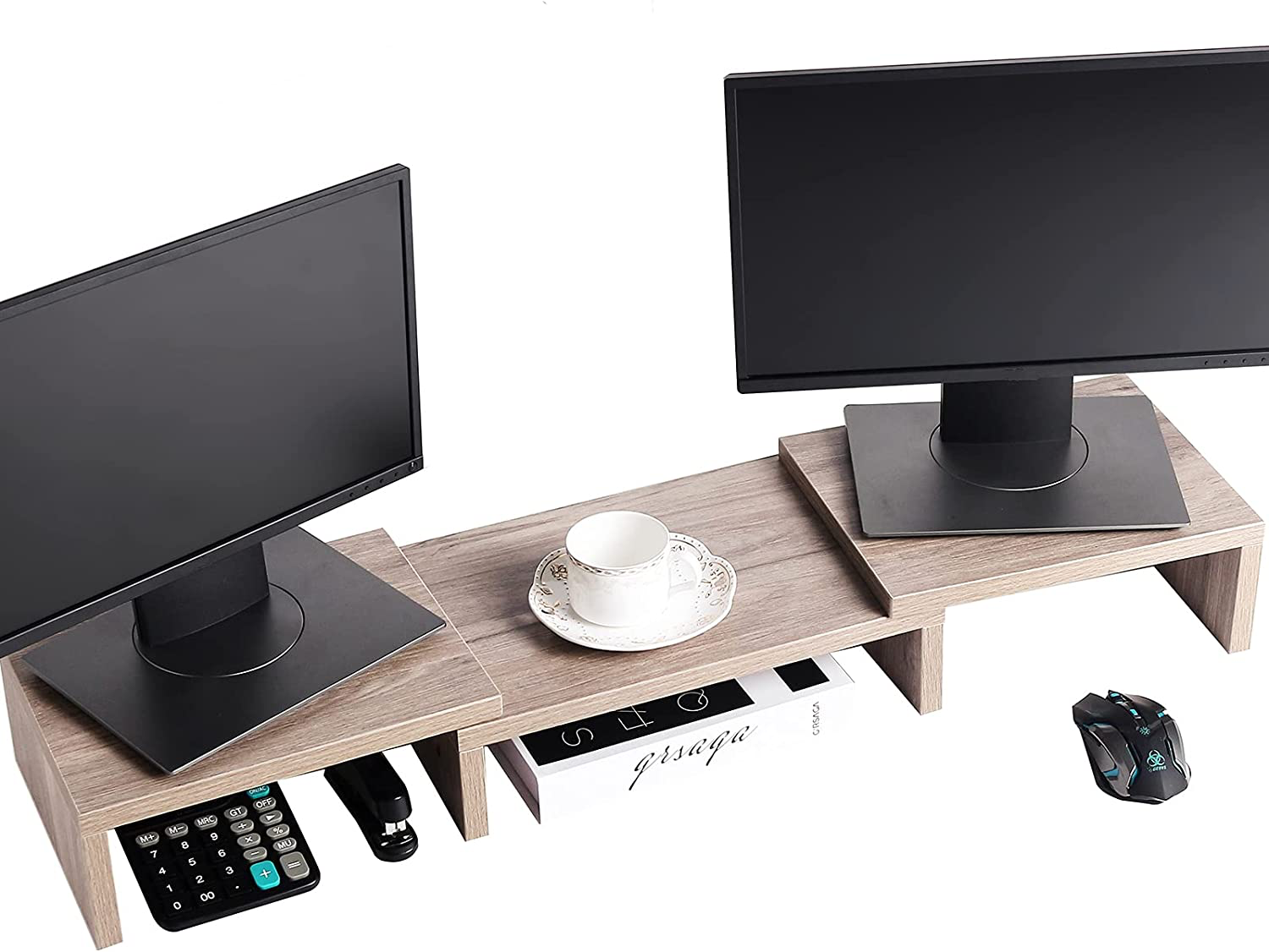
Item: SUPERJARE Monitor Stand Riser, Adjustable Screen Stand for Laptop Computer/TV/PC
https://www.amazon.com/gp/product/B07NPJZGVR/ref=ppx_yo_dt_b_asin_title_o09_s00?ie=UTF8&th=1
Condition: Good
Original Price: $33
Sale Price: $10

Slide 7
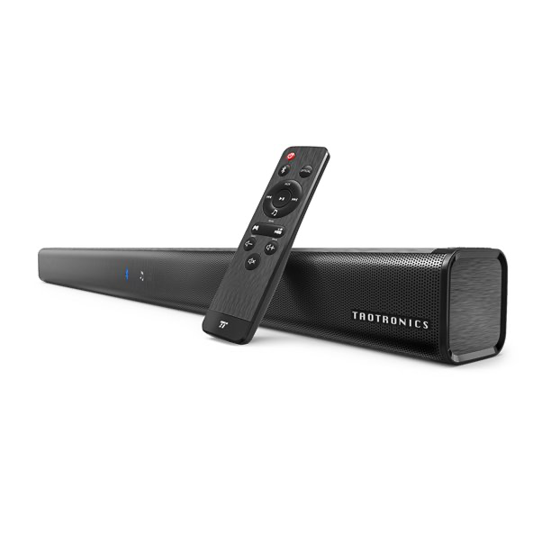
Item: TaoTronics Soundbar 32-Inch Audio Speaker for TV, Wired and Wireless Bluetooth 5.0
https://www.walmart.com/ip/TaoTronics-Soundbar-3-Equalizer-Modes-32-Inch-Audio-Speaker-TV-Wired-Wireless-Bluetooth-5-0-Stereo-Soundbar-Optical-Aux-RCA-Connection-Wall-Mountable/898679068
Condition: Like-new
Original Price: $56
Sale Price: $30
Pending

